Slide 1
Transportation Metrics Correlation Analysis
Ting Sun

Slide 2
Recap from last time
We systematically evaluated Pearson (linear) correlations among 23 metrics:
We observed a lot of highly-correlated pairs in both auto-correlation and cross-correlation.
We explored a few pairs in-depth to validate business implications.
We decomposed a few metrics to confirm their cyclic nature

Slide 3
Update since last time – in-depth cross-correlation analysis
Completed in-depth cross-correlation analysis based on previous feedback:
Breakdown of Railway carload into eight categories and consolidated them into one overall correlation metrics analysis. (PBI Report -- CrossCorrelation_DeepDive)
Agriculture
Automotive
Chemicals & Petro
Coal
Forest Products
Intermodal
Metals & Minerals and Other
Reduce from 24-month lead/lag to 12-month period
We have identified some highly positively correlated pairs, and can further investigate
Minerals & Metals with Cass Shipment as well as Weekly Avg Class 1 Rail Volume
Chemicals & Petro with ATA Truck (Tonnage) _6, IANA Domestic Containers _0, Intermodal_0
Computed the average 3- month lead and lag metrics across all pairs. (PBI Report -- Lead&lag 3mthAvg)
Strong linear correlation between 3-month lead/lag
Highly correlated pairs are identified: available to view from PBI dashboard
Next Step: Michael to review and provide feedback
Note: weekly data prorated for monthly computation

Slide 4
Causality test revealed some high causal relationships among various metrics
We did causal inference analysis for Trucking metrics:
PBI Report -- Causality
Lower p-value indicates more significance of causality
Identified some metrics with high causal relationships (next page for details)
IP
Trucking Market Index
…

Slide 5
Causal inference analysis for Trucking Metrics-- pvalue
 | ATA Truck (Tonnage)_x | Backlog/Build_x | Class 8 Truck Orders_x | Exports (TEUs)_x | IANA Domestic Containers_x | IP_x | Imports (TEUs)_x | Monthly Labour_x | Real GDP_x | Spot Container Rates (HK-LA)_x | Spot Dry Van TL Pricing (includes fuel)_x | Spot Flatbed TL Pricing (includes fuel)_x | Trucking Market Demand Index_x
ATA Truck (Tonnage)_y | 1 | 0.0764 | 0.3003 | 0.056 | 0.0039 | 0 | 0.0053 | 0.005 | 0 | 0.2491 | 0.0087 | 0.0641 | 0.2701
Backlog/Build_y | 0.1862 | 1 | 0.5904 | 0.1243 | 0.0842 | 0 | 0.0006 | 0.0074 | 0 | 0.648 | 0.0594 | 0.063 | 0.0035
Class 8 Truck Orders_y | 0.2877 | 0.0109 | 1 | 0.2814 | 0.0014 | 0.0314 | 0.0215 | 0.3541 | 0.1376 | 0.0521 | 0.0003 | 0.0034 | 0
Exports (TEUs)_y | 0.0061 | 0 | 0.0611 | 1 | 0 | 0.0086 | 0 | 0.0242 | 0.1378 | 0.0008 | 0 | 0 | 0.0002
IANA Domestic Containers_y | 0 | 0 | 0.0509 | 0 | 1 | 0 | 0 | 0 | 0 | 0 | 0 | 0 | 0
IP_y | 0.0409 | 0.1248 | 0.6859 | 0.0691 | 0.2066 | 1 | 0.0139 | 0.0613 | 0.0016 | 0.274 | 0.1246 | 0.2409 | 0.0047
Imports (TEUs)_y | 0.0012 | 0.0008 | 0.0109 | 0 | 0 | 0.001 | 1 | 0 | 0.0029 | 0.0332 | 0.0004 | 0.0006 | 0
Monthly Labour_y | 0.0612 | 0 | 0.0572 | 0.0067 | 0.0014 | 0 | 0.0023 | 1 | 0.0118 | 0.0042 | 0.0235 | 0.0003 | 0.1229
Real GDP_y | 0.2619 | 0.0068 | 0.4735 | 0.1438 | 0.3922 | 0.0001 | 0.0078 | 0.5515 | 1 | 0.1978 | 0.0911 | 0.0436 | 0.1749
Spot Container Rates (HK-LA)_y | 0.19 | 0.001 | 0.0029 | 0.0001 | 0 | 0.0006 | 0.1307 | 0 | 0.0041 | 1 | 0 | 0.0009 | 0.0006
Spot Dry Van TL Pricing (includes fuel)_y | 0.0762 | 0.0004 | 0.025 | 0 | 0 | 0.0051 | 0 | 0 | 0.0003 | 0.0003 | 1 | 0 | 0
Spot Flatbed TL Pricing (includes fuel)_y | 0.4166 | 0.0003 | 0.0229 | 0.0382 | 0.0005 | 0 | 0 | 0.0009 | 0 | 0.0321 | 0 | 1 | 0.0001
Trucking Market Demand Index_y | 0.2776 | 0.0016 | 0.0004 | 0.0064 | 0 | 0.0001 | 0.0001 | 0.0813 | 0.002 | 0.0009 | 0.0095 | 0.0045 | 1
* _y dependent variable _x independent variable ** based on Granger causality test for time series
Notes:
Test whether X values provide statistically significant information about future values of Y.
Interpretation: for example :
1.Trucking Market Demand causality impact all metrics except Monthly labour and GDP and ATA truck (even with some with high correlation)
2. backlog/build, IP, import and export causality impact Real GDP for example

Slide 6
Fourier transformation predication showed a decent baseline
We applied Fourier transform for a few time series as a signal processing and prediction:
Used historical data to predicate 2nd half of 2019 and Mar 2020 to Sep. 2020(the last data points).
Descent prediction accuracies for majority of metrics for 2019,
Some predication underperforms when predicting pandemic 2020.
Model can be further improved with some parameter tuning
PBI Report -- predictions

Slide 7
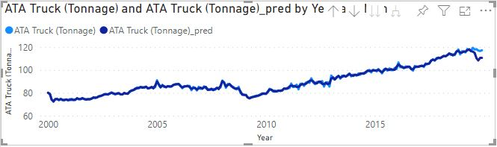
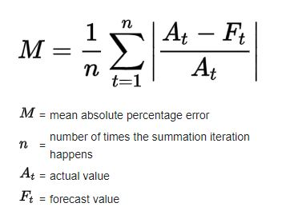
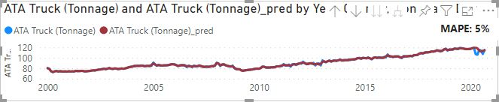
Fourier transformation works well with ATA Truck Tonnage predication
MAPE: Mean Absolute Percentage Error
Predication of H2/2019 with 5% MAPE.
Predication of Mar – Sep /2020 with 5% MAPE.

Slide 8
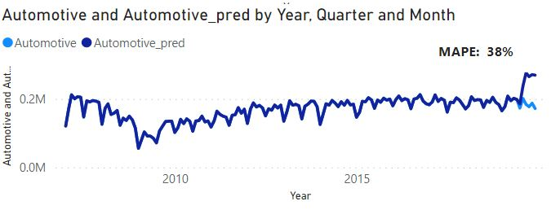
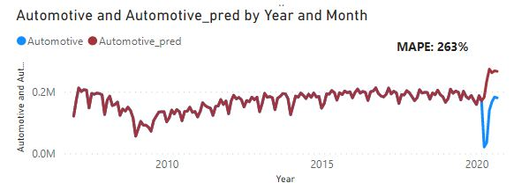
Fourier transformation doesn’t work well yet with Automotive predication
Predication of H2/2019 with 38% MAPE.
Predication of Mar – Sep /2020 with 263% MAPE.

Slide 9
Appendix – materials from last update

Slide 10
We explored 23 metrics and some Pearson correlations examples
 |  | Value | Type
Trailing 3-Month SAAR | Class 8 Truck Orders_lag_1mth | 0.948937 | Cross-Correlation
IANA Domestic Containers | ATA Truck (Tonnage)_lead_20mth | 0.938335 | Cross-Correlation
Monthly Labour | Monthly Labour_lead_1mth | 0.993170 | Auto-Correlation
Trucking:
ATA Truck (Tonnage) Spot Container Rates (HK-LA) Spot Dry Van TL Pricing (includes fuel)
Spot Flatbed TL Pricing (includes fuel) Class 8 Truck Orders Trucking Market Demand Index
Freight:
Air Freight Price (Index) Cass Shipment (Index) Volumes (FTKs)
Shanghai Pudong Air Cargo (PACTL) (Tonnage) Capacity (AFTKs)
Rail:
IANA Domestic Containers Imports (TEUs) Exports (TEUs)
VA Export Coal Loadings (Tons 000s) Weekly Avg. Class I Rail Volumes (Carloads + Intermodal)
Operating/other Metrics:
Monthly Labour Backlog/Build Domestic Integrator Volumes Intl Integrator Volumes
Trailing 3-Month SAAR
Macro: Real GDP IP
Preprocessing:
'Monthly Labour’: Sum over all companies
IP and Real GDP: quadratic interpolation from quarterly to monthly

Slide 11
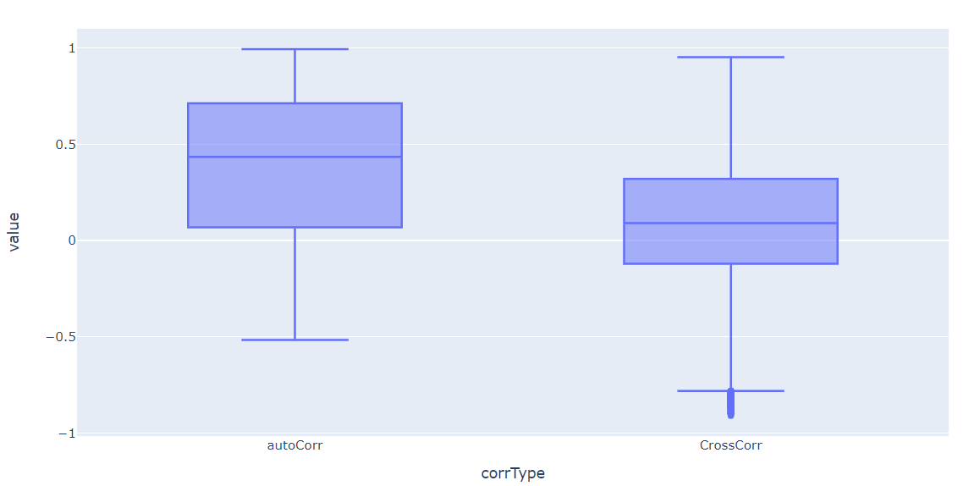
With >600K correlation measures, we have observed a lot of highly correlated pairs.
Consider lag and lead of 24 months, we have a correlation matrix of 1104X 1104.
Over 600K unique correlation measures.
Separated them into ‘cross correlation’ and ‘auto correlation’
 | AutoCorrelation (4%) | CrossCorrelation (96%)
mean | 0.39 | 0.11
median | 0.43 | 0.09
Min | -0.5 | -0.91
max | 0.99 | 0.95
Abs(corr) | AutoCor. | CrossCor.
>0.95 | 1578 (6%) | 4
[0.9,0.95] | 1239(5%) | 1577(0.3%)
[0.75,0.9] | 2869(11%) | 16155(3%)

Slide 12
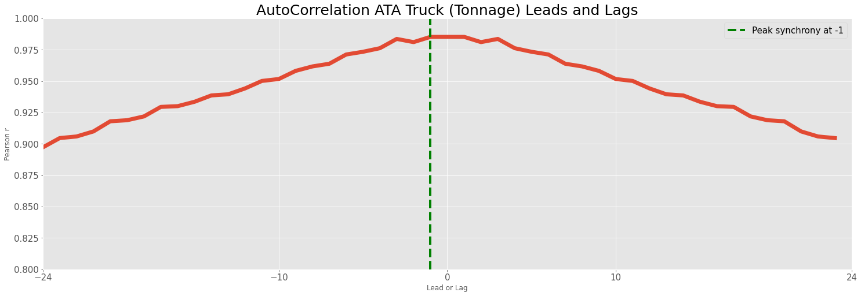
An example of time lagged auto correlation: ATA Truck Tonnage
ATA Truck Tonnage tops the list of auto correlation with highest of 0.985 and lowest around 0.9
Correlation is symmetric between lead and lag
Auto correlation reaches the highest with lag and lead of 1 month

Slide 13
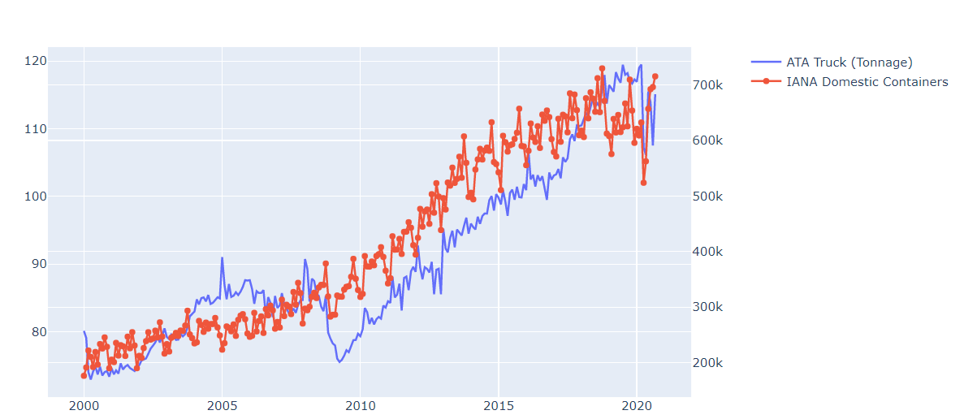
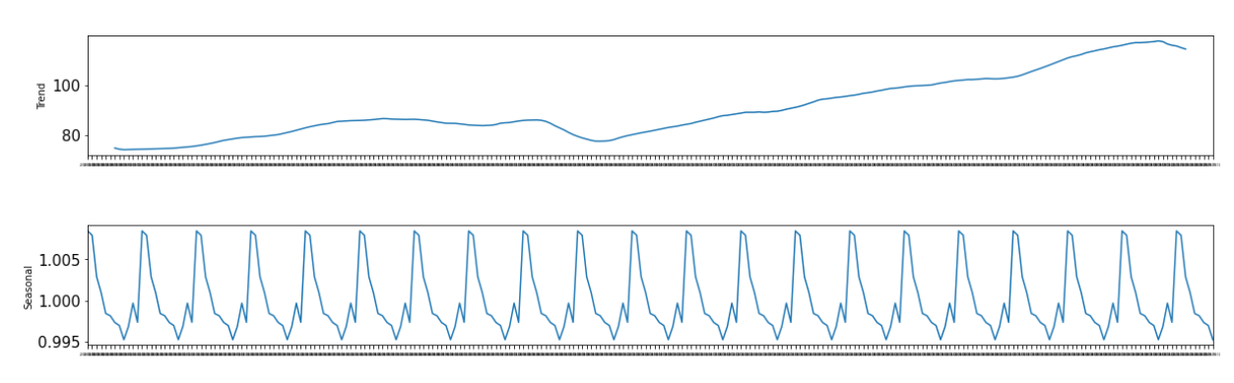
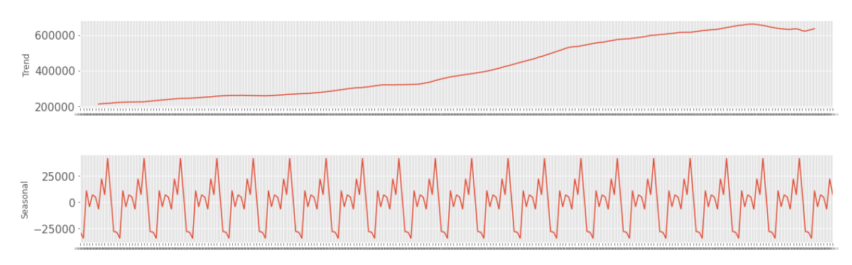
Decomposition of some metrics confirmed our hypothesis on their cyclic nature.
Seasonal Decomposition of ATA Truck (Tonnage)
Seasonal Decomposition of IANA Domestic Containers
Starting from 2000-01

Slide 14
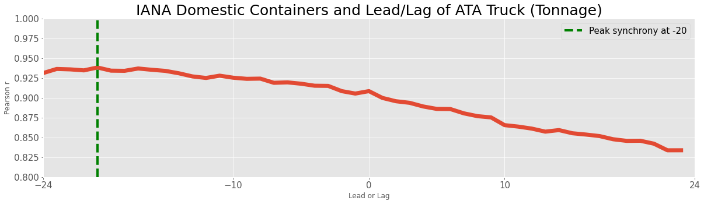
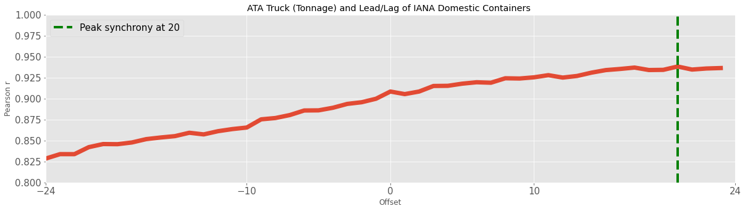
Example: Time lagged cross correlation between ATA Truck and IANA Domestic Containers
Correlations between ATA Truck(Tonnage) and leads and lags of IANA Containers tops cross-correlation measures (80% of Top 50)
Correlation is maximized at 20th month lag of IANA domestic containers or ATA truck tonnage is pulled forward by 20 months
ATA truck tonnage leads domestic containers.

Slide 15
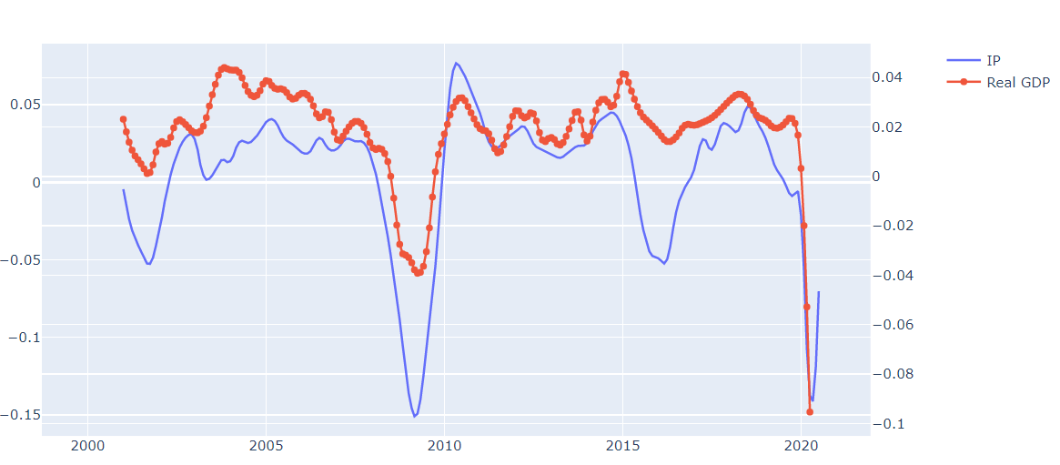
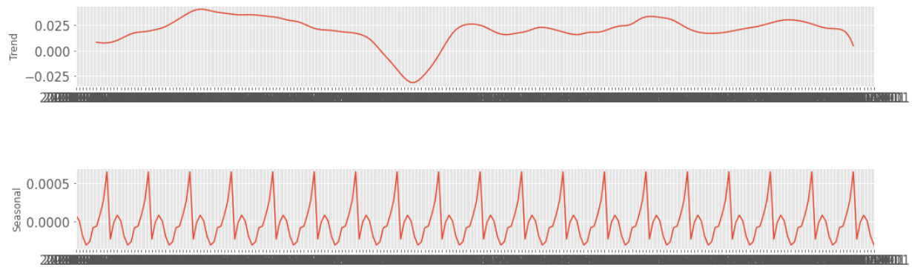
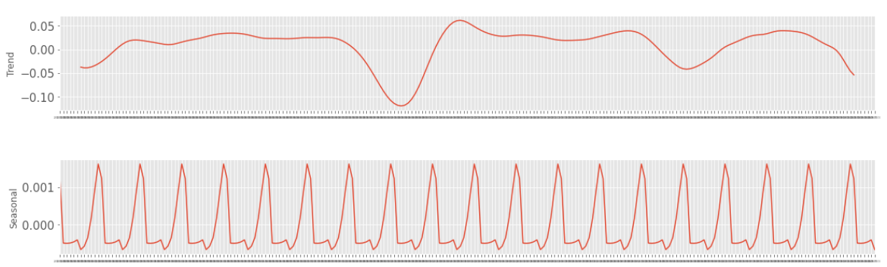
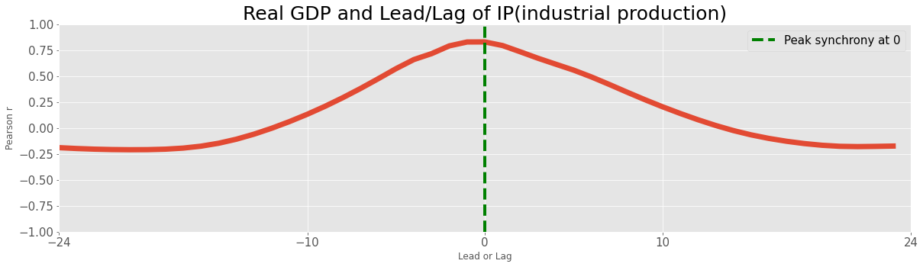
Example: Real GDP and industrial production cross correlation.
Seasonal Decomposition of GDP
Seasonal Decomposition of IP
Synchrony between GDP and IP
*From 2002-01

